Slide 1

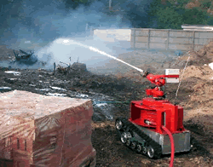
ME395
AUTOMATIC FIRE TRUCK

Slide 2

Introduction
Equipment Overview
Procedure
Project Model
Conclusion

Slide 3
Introduction
In this report we thoroughly look into the working of a Automatic fire truck.
An automatic fire truck is designed to detect and respond to fires without human involvement, providing a rapid and efficient emergency response.
For this we use open source hardware Arduino where our truck gets commands in the form of source code.
Whenever it detects the fire it will move towards the direction of fire and spills water on it.

Slide 4

EQUIPMENT OVERVIEW
Flame Sensor
Bluetooth Module
Battery
Jumper wires
Bread Board
Arduino UNO
LC Driver
Motor Pump
Chassis
Motors
Water tank

Slide 5
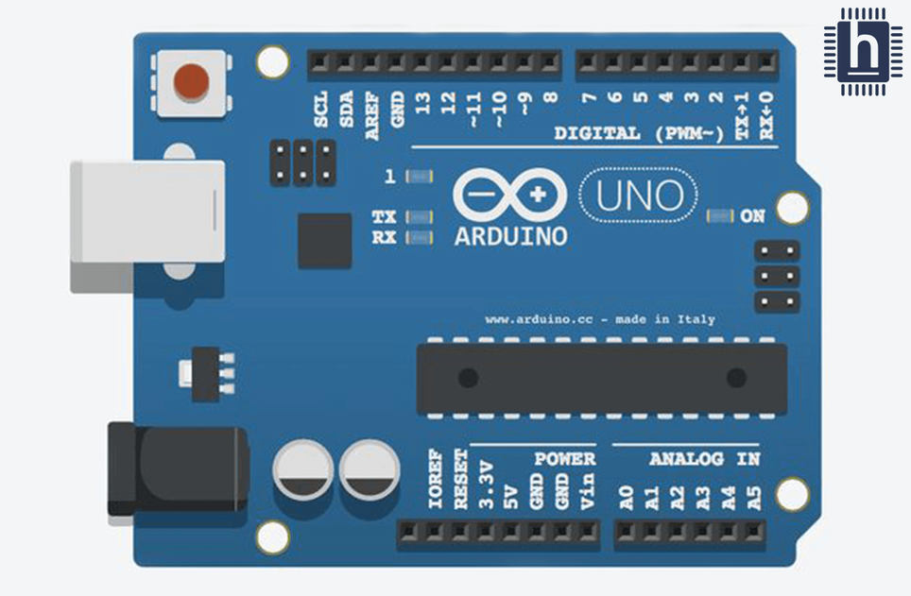
ARDUINO UN0
Arduino is an open-source electronics platform that consists of both hardware and software components.
It comes with digital and analog input/output pins that can be programmed to interact with various electronic components such as sensors, motors, and displays.
It can be programmed using the Arduino IDE (Integrated Development Environment), and it supports a variety of programming languages.
This arduino uses a standard USB Type-B connector for communication with a computer.

Slide 6
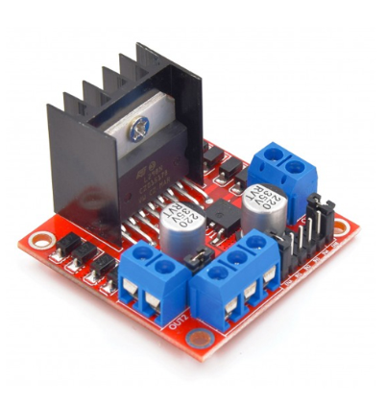
LC MOTOR DRIVER(L298N)
The L298N is a dual H-bridge motor driver, which means it can control two DC motors independently.
Each H-bridge allows the motor to be driven forward or backward with the help of two control signals (input pins) for each motor.
The L298N is a popular motor driver integrated circuit (IC) commonly used to control the direction and speed of DC motors. It is widely used in robotics and other applications where motor control is necessary.

Slide 7
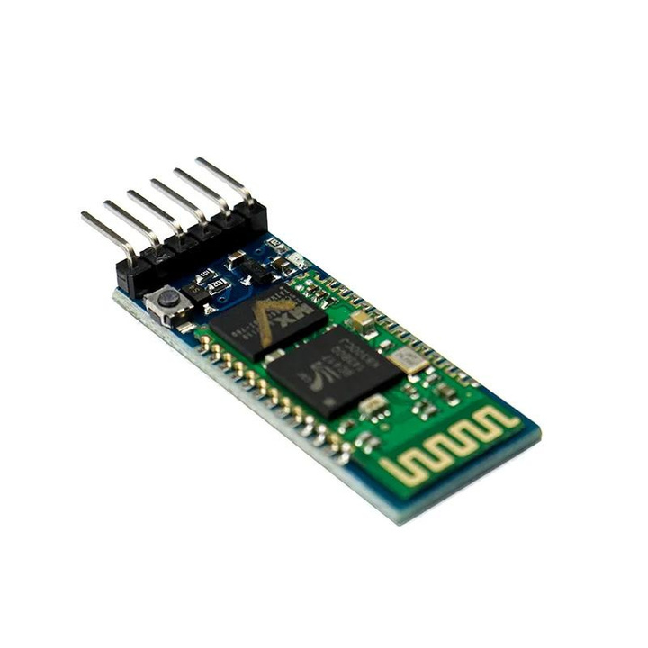
BLUETOOTH MODULE
A Bluetooth module is a hardware component that enables wireless communication between electronic devices over short distances.
These modules are commonly used in various applications, including wireless communication between electronic devices, IoT (Internet of Things) projects, robotics, and more.
Bluetooth devices typically use a process called "pairing" to establish a secure connection. During pairing, devices exchange encryption keys to ensure that the data transmitted between them remains confidential and protected against unauthorized access.

Slide 8
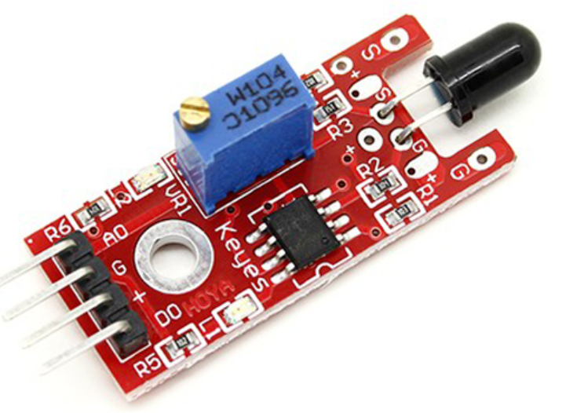
FLAME SENSOR
A flame sensor is a device designed to detect the presence of a flame or fire. It is commonly used in various applications for fire safety and automation.
The primary function of a flame sensor is to provide feedback on the existence of a flame.
In case of fire a small amount of Infrared light is emitted, sensor detects this IR light and gives output signal accordingly.

Slide 9

Procedure
Flame Sensors contains the IR receiver (photodiode) which is used to identify fires.
A tiny quantity of infrared light is released as a fire burns, and the sensor module's IR receiver will pick up this light.
If a fire is found, the output pin (DO) will indicate 0V (LOW), and if not, it will indicate 5V (HIGH).
Following the flame sensor's detection of a fire, the Arduino will instruct the LC Driver to move the truck using the source code it has been given.

Slide 10

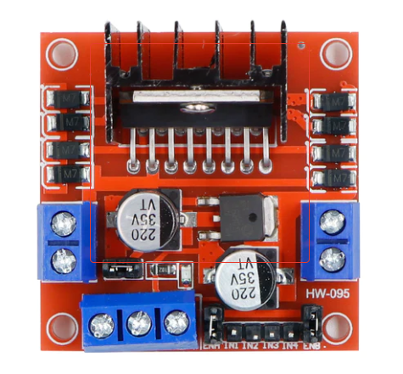
If the fire is straight ahead of the Truck. Then pins 1 and 3 read HIGH, and pins 2 and 4 read LOW. Potential difference will occur, enabling the motor to obtain power and propel the wheels ahead. So that the truck will move forward.
1
4
2
3
2. If the fire is to the left then pins 2 and 3 reads HIGH and pins 1 and 4 reads LOW. So that there will be positive potential difference in the right direction and on the left the situation will be reverse. As a result, the truck can turn to the left because the right tires will travel forward and the left tires will go backward.

Slide 11
3. If the fire is to the right then pins 2 and 3 reads LOW and pins 1 and 4 reads HIGH. So that there will be positive potential difference in the left direction and on the right the situation will be reverse. As a result, the truck can turn to the right because the left tires will travel forward and the right tires will go backward.
4. When the truck reaches a predetermined distance from the fire it stops, the water pump's pin reads HIGH which will cause the linked pipe to spill water over the fire, extinguishing it.
May

Slide 12
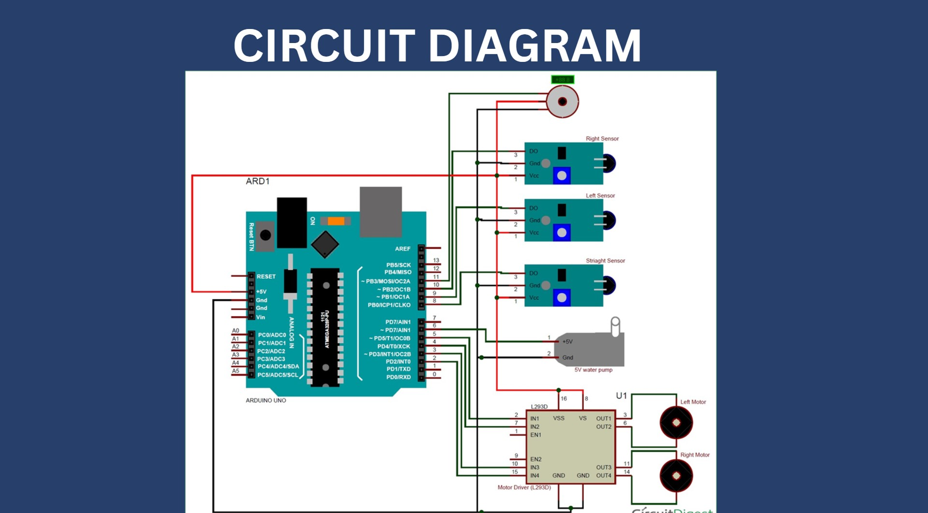

Slide 13
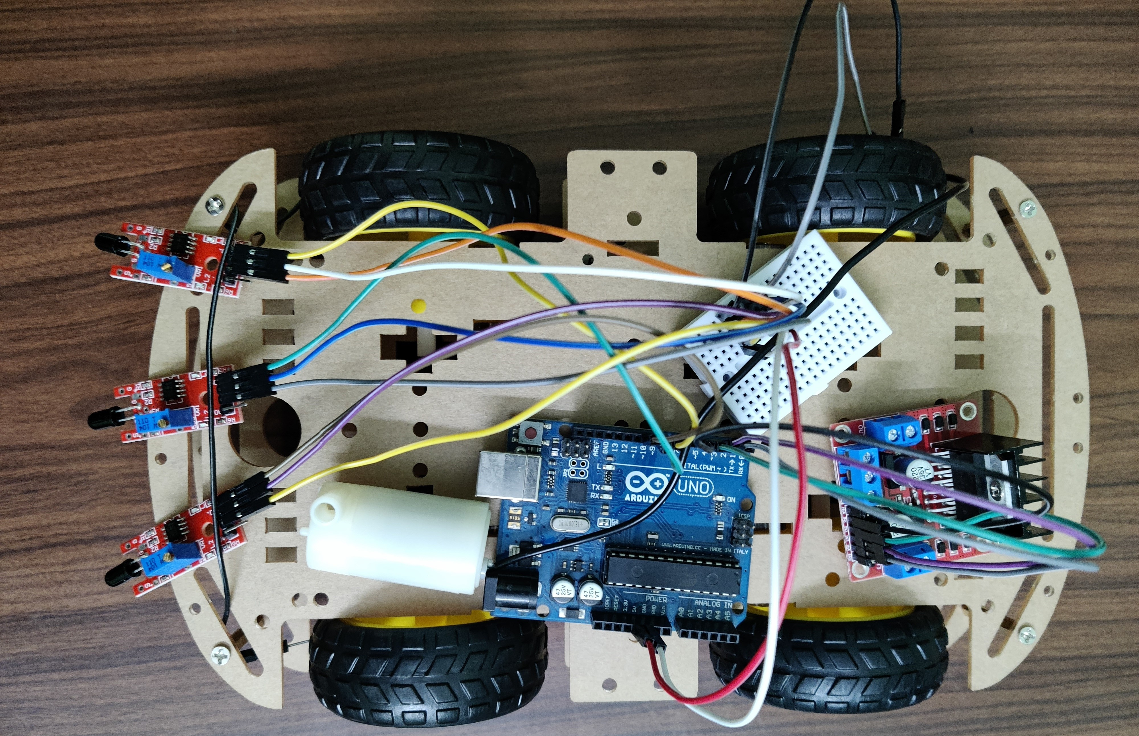

Slide 14
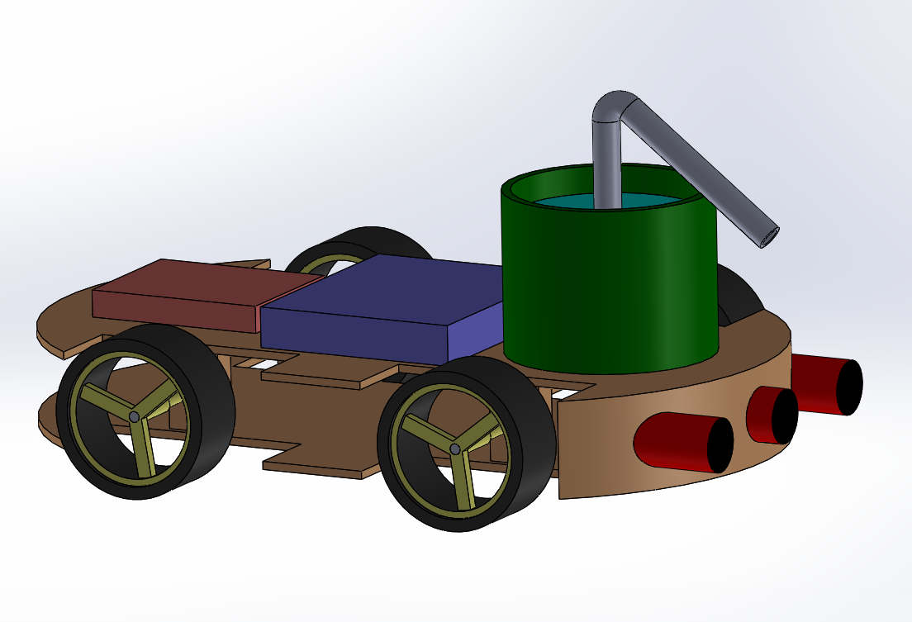
PROJECT MODEL

Slide 15

Model Video

Slide 16
CONCLUSION
There are some companies that are performing trails on automatic firetrucks. Those are:
Ezitracker (Australia)
BionicHIVE (Singapore)
Robotise (Belgium)
In our project the automatic firefighting truck has a very low detecting range because there is a limit for the sensor.
To overcome this fault we are making the firetruck to be remote controlled.

Slide 17

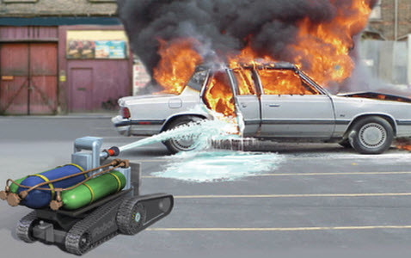
If the fire be outside the sensor's detection range, then we will utilize the remote control to guide the truck and bring it within the truck's detection range.
So in the next semester we will be adding bluetooth module which helps us to steer our truck which can be controlled through app.

Slide 18
References
Bluetooth Controlled Car | Arduino Project Hub
DIY Arduino Based Fire Fighting Robot Project with Code and Circuit Diagram (circuitdigest.com)
3) India's Favourite Robotics and DIY Store – Robocraze

Slide 19
MENTOR : DR. SOMNATH SARANGI
TEAM MEMBERS:
G.Meghshyam 2101ME24
AP.Giriteja 2101ME03
S.Kartheek 2101ME68
D.Yuvakiran 2101ME21
A.Navneeth Singh 2101ME04

Slide 20


THANK YOU

